Slide 1
Bilingualism and Autism Spectrum Disorders
Stella Kyprianou
City University of New York, Brooklyn College

Slide 2
Bilingualism
a very common phenomenon and increasingly spread worldwide (Grosjean, 2010; Valicenti et al 2012)
standard practice for approximately two thirds of the world’s population (Drysdale et.al 2015)

Slide 3
More than 50% of the world is bilingual.
Monolingual: A person knowing only one language (40% of world population)
Bilingual: A person using or able to use two languages especially with equal fluency (43% of world population)
Trilingual: A person speaking three languages fluently (13% of world population)
Multilingual: A person who speaks more than two languages, but used often for four languages or more (3% of world population speak more than 4 languages)
Polyglot: Someone with a high degree of proficiency in several languages (less than 1‰ of world population speak 5 languages fluently)

Slide 4
Language Other Than English Spoken in the United States
The United States is home to individuals from a wide variety of culturally and linguistically diverse backgrounds.
21% of speak LOTE at home.
Of the 60.6 million people who speak LOTE, almost two-thirds (37.6 million; 13% of the total population) speak Spanish.
Language in addition to spoken at home by at least 1 million people:
Chinese (2.9 million),
Tagalog (1.6 million),
Vietnamese (1.4 million),
French (1.3 million),
German (1.1 million),
and Korean (1.1 million)

Slide 5
In the US schools….
More than 11 million public school students speak at least one of 400 different languages other than English at home

Slide 6
In the US schools by 2030…
ELL students are projected to comprise 40% of the school-age population by 2030 (Schon et al., 2008)

Slide 7
Hispanic/Latino children population in the US
Hispanic/Latino children: approximately 22% of the population under the age of 18.
Nearly half (47%) of children younger than 5 comprised a minority group in 2008, with 25% being Hispanic/Latino
The Hispanic/Latino population: numerically, the largest growing minority group in the U.S.
A more recent investigation: estimated that the number of people with Hispanic or Latino origin grew by almost 4.8 million between 2010 and 2014.

Slide 8
Bilingualism and ASD
Our student body becomes progressively more diverse (Yu, 2013),
It’s evidently expected that educators and healthcare providers will encounter bilingual children with disabilities in their caseloads (Lund et. al 2017)

Slide 9
Prevalence of students with ASD who are of Hispanic and Latino origin.
The CDC: 14.6 out of every 1000 children had a diagnosis of ASD in 2012.
Prevalence of Hispanic children with ASD was estimated to be 10.2 out of every 1000 (CDC; Baio, 2016)
In a descriptive study, Jo, et al. (2015) suggested that may be under-identified for autism as a result of differences in culture and limited access to services Hispanic children in the United States whose home language was not English.
Therefore, the prevalence of Hispanic children with autism may be higher than reported by existing investigations

Slide 10
Bilingualism and ASD…concerns..
Many professionals working with bilingual families of children with ASD
concerned that the bilingual language context might lead to further language learning difficulties
often recommended that bilingual families of children with ASD focus on the language of schooling and refrain from using the family’s home language
Families document that they are advised by teachers and other healthcare professionals to limit exposure to a second language as that might negatively affect the language acquisition of children with ASD
Recent research has questioned whether these recommendations…

Slide 11
-Does bilingualism truly increase language delays in children with ASD?
-Will bilingualism lead to language confusion in these children?
-What are the implications of recommendations that discourage bilingualism, both for the child’s development and for the family’s overall well-being

Slide 12
Survey of Bilingualism in Autism Spectrum Disorders by Kay Raining-Bird et al (2012)
Examined the language abilities of bilingual children with ASD.
Parents reported:
professionals did not always support their choice.
living in a bilingual community and the need to communicate with various people in a variety of venues supported a bilingual choice
Concerns: lack of services and supports and concerns about whether their children would be able to learn two languages.

Slide 13
The Impact of Bilingual Environments on Language Development in Children with Autism Spectrum Disorders by Hambly and Fombonne (2012)
compared the social abilities and language levels of children with ASD who are raised in monolingual and bilingual environments.
Participants: 45 bilingual and 30 monolingual (mean age = 56 months) children
No signiﬁcant group differences in language level. Bilingually-exposed children with ASDs did not experience additional delays in language development.

Slide 14
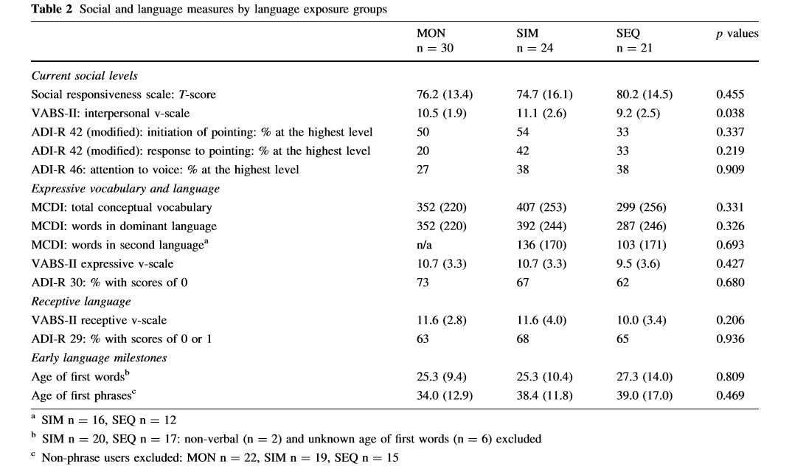

Slide 15
Brief Report: An Exploratory Study of Lexical Skills in Bilingual Children with Autism Spectrum Disorder by Peterson et al. (2012)
lexical comprehension and production and overall language skills were investigated
Results: both groups had equivalent scores on all but one measure of language and vocabulary, including English production vocabulary, conceptual production vocabulary, and vocabulary comprehension.
When comparing the two languages of bilingual participants, there were no signiﬁcant differences in production vocabulary size or vocabulary comprehension scores.

Slide 16
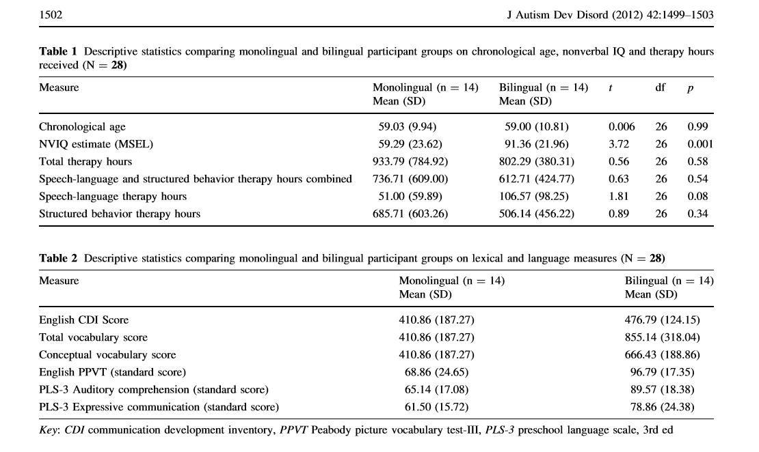

Slide 17
Comparing Early Language Development in Monolingual- and Bilingual- Exposed Young Children with Autism Spectrum Disorders by Ohashi et al. (2012)
Purpose: to compare a group of recently diagnosed bilingual-exposed children with autism.
No statistically significant differences between the two groups on any of the language measures were observed. The results suggest that a bilingual language environment does not disadvantage young children with autism in the early stages of language development

Slide 18
Language Differences Between Monolingual English and Bilingual English-Spanish Young Children With Autism Spectrum Disorders by Valicenti-McDermott et al. (2013)
Goal: compare expressive and receptive language in monolingual and bilingual children with ASD.
Compared with monolinguals, bilingual children were more likely to vocalize and utilize gestures, with no other differences in language skills.
no differences in cognitive functioning and autistic features between the groups.
In this study, bilingualism did not negatively affect language development in young children with ASD.
Bilingually exposed children with ASD used more communicative gestures and engaged in more imaginative play than their monolingual counterparts.

Slide 19
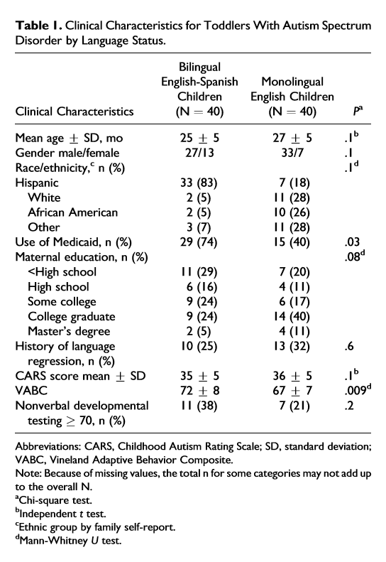

Slide 20
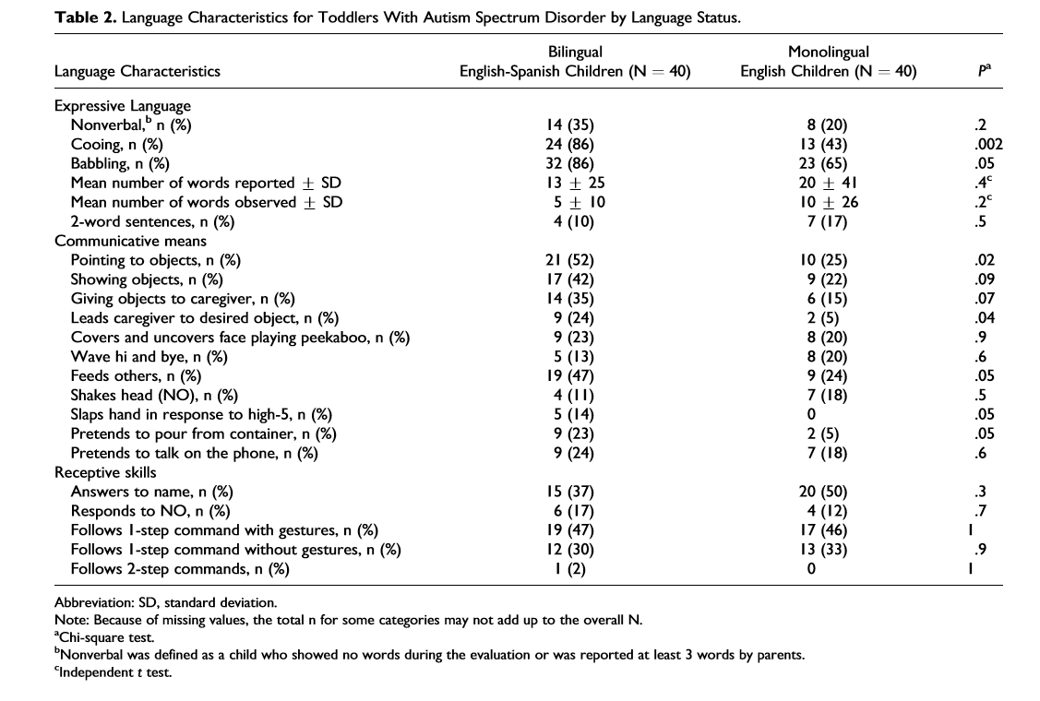

Slide 21
Factors influencing bilingual expressive vocabulary size in children with ASD by Hambly and Fombonne (2014)
Purpose: Explored bilingual exposure, language, social impairment and cognitive factors that influence second language (L2) expressive vocabulary.
Results: higher levels of recent L2 exposure and higher dominant language vocabulary were associated with higher L2 vocabulary for children with ASD.
greater level of exposure to a L2 facilitate second language skills for children with ASD.

Slide 22
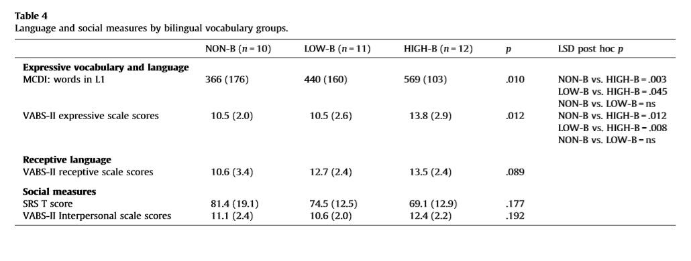

Slide 23
Communicative Development in Bilingually Exposed Chinese Children With Autism Spectrum Disorders by Reetzke et al (2015)
Purpose: to examine the association of bilingual exposure with structural and pragmatic language development Results: Bilingually exposed children with ASD did not demonstrate significantly different performance on any standard measure relative to their monolingual peers.
Results: bilingual language exposure is not associated with additional challenges for the development of the dominant language

Slide 24
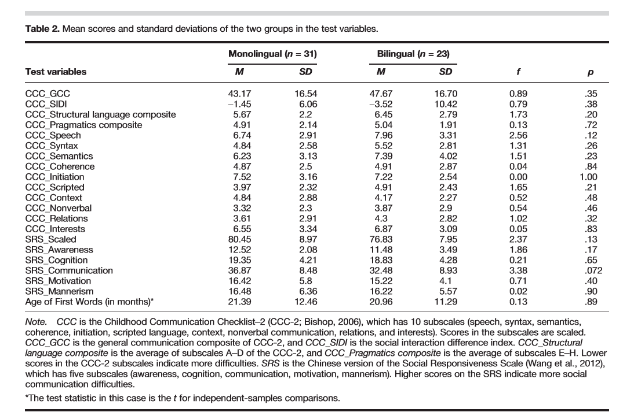

Slide 25
Experiences of Parents
Parents express concerns
bilingualism would be confusing for their child
- amplify language delays already present due to ASD

Slide 26
For bilingual families
Maintaining parent’s native language and parent–adolescent relationships
Parents who used only English with their child
- decline in interactions with their child
-decline in the child’s participation in family conversations
Impact of a minority language versus a majority language
vital role for in maintaining cross-generational relationships
fostering group identities
preserving cultural heritage
leads to closer family bonds when language is used.

Slide 27
Our current study
To investigate the receptive and expressive skills of monolingual (English only) and bilingual (English-Spanish) preschool students with (ASD)
To study bilingual parents’ experiences with special education services and language choices for their children with ASD.
Our goal is to recruit 80 preschool students with a confirmed diagnosis of ASD
Approximately 40 monolingual English
and
Approximately 40 bilingual English-Spanish

Slide 28
Goal for number of participants
80 preschoolers will participate in the study.
Approximately 40 monolingual English
and
Approximately 40 bilingual English-Spanish
preschool students ages 3-5.

Slide 29
Both groups will receive the - Battelle Developmental Inventory 2nd edition (BDI-2)English OR Spanish -Childhood Autism Rating Scale-Second Edition (CARS-2) Standardized and normed referenced language tests that are available in both English and Spanish
Monolingual English
Bilingual Spanish
Preschool Language Scale Fifth Edition (PLS-5) English
Receptive One Word Picture Vocabulary Test 4th edition (ROWPVT-4) English
Expressive One Word Picture Vocabulary Test 4th edition (EOWPVT-4) English
MacArthur Bates Communicative Development Inventory (CDI-English)
Preschool Language Scale Fifth Edition (PLS-5) Spanish
Receptive One Word Picture Vocabulary Test 4th edition (ROWPVT-4) Spanish
Expressive One Word Picture Vocabulary Test 4th edition (EOWPVT-4) Spanish
MacArthur Bates Communicative Development Inventory (CDI-Spanish)

